Slide 1
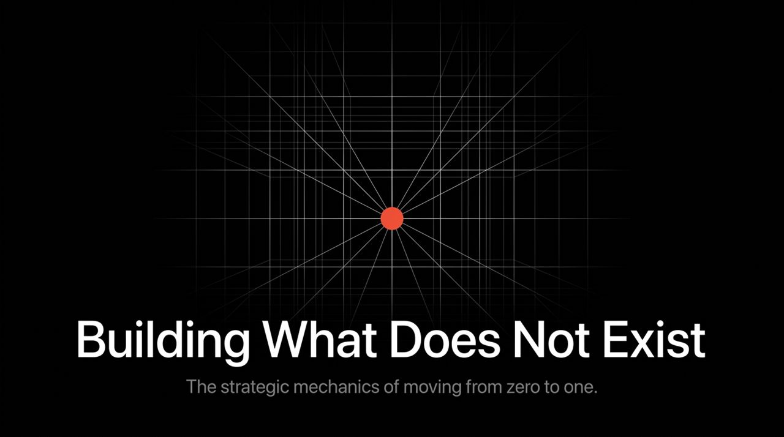
Notes:
Welcome everyone. Today, we're talking about a fundamental question facing every founder, creator, and executive: How do we build something truly valuable in a world saturated with noise?
When you look at today's business landscape, most markets resemble the image on this slide: a tightly packed container where dozens of companies are crammed together, fighting over the exact same space.
Every major breakthrough in business and technology has come from doing something that had never been done before. The next Bill Gates won't build an operating system. The next Larry Page won't build a search engine. And the next Mark Zuckerberg won't build a social network.
If you copy these people, you aren't learning from them. Over the course of this talk, we're going to explore the strategic mechanics of moving away from crowded competition and mastering the art of moving from zero to one.
https://www.youtube.com/watch?v=Eu0ShMNCChY

Slide 2
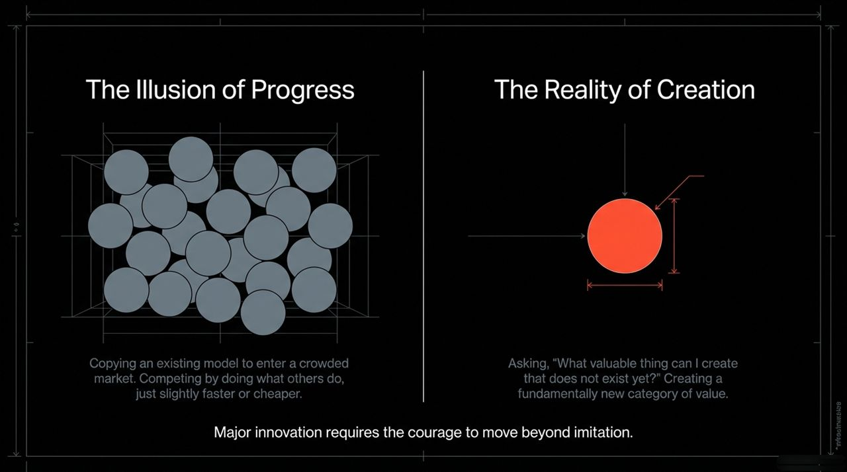
Notes:
Let's unpack a common delusion in corporate strategy: confusing busyness or incremental improvement with actual progress.
The Illusion of Progress happens when you take an existing business model, enter a crowded market, and compete by tweaking speed or lowering pricing by 5%. You might feel like you're winning because you're busy fighting competitors, but you're actually engaged in value destruction.
The Reality of Creation requires asking a radically different question: 'What valuable thing can I build that does not exist yet?'
Imitation feels safe because there is already a market proving demand. Creation feels risky because you are stepping into the void. But major economic leaps require the courage to stop copying others and start building fundamental value.

Slide 3
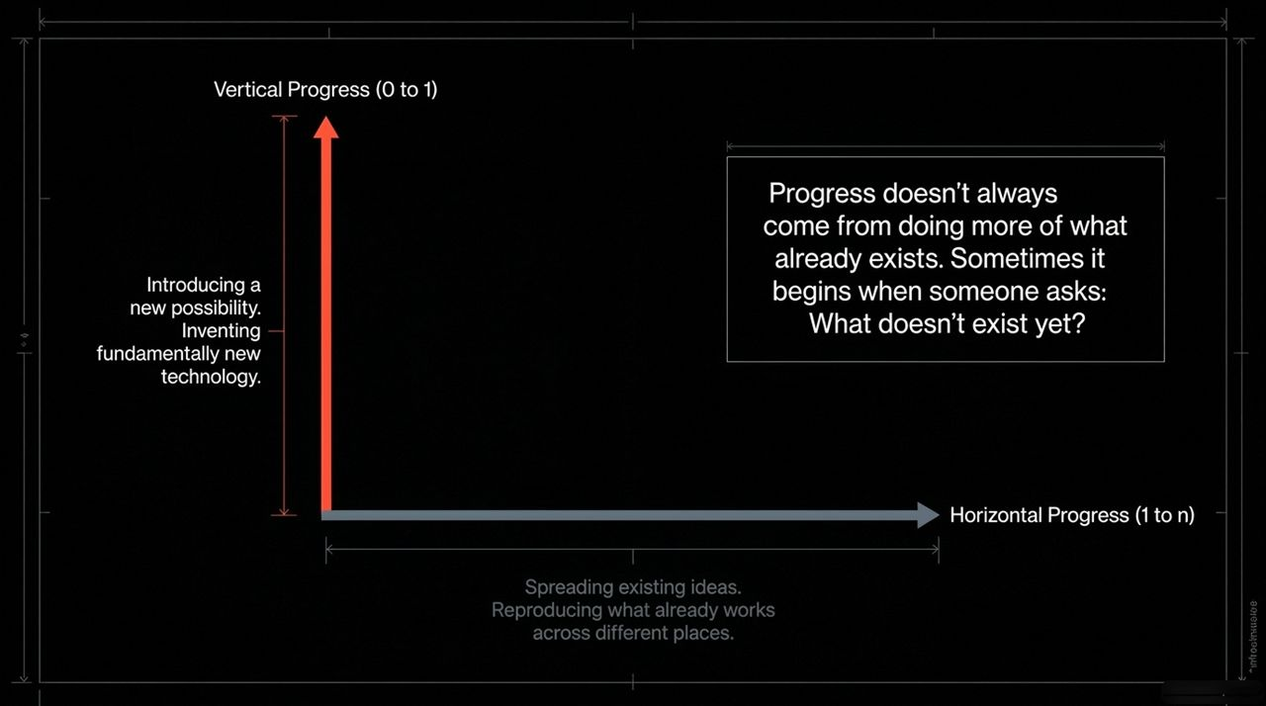
Notes:
To visualize this clearly, imagine progress along two axes:
Horizontal or Extensive Progress (1 to n): This is moving along the horizontal axis. It means taking something that already works and copying it, distributing it, or scaling it. If you take one typewriter and build 100 of them, that is horizontal progress. Globalization is largely horizontal progress—taking things that work in the West and bringing them to other parts of the world.
Vertical or Intensive Progress (0 to 1): This is moving up the vertical axis. It means doing something nobody else has ever done. If you have a typewriter and you build a word processor, you have made vertical progress.
Horizontal progress is easy to imagine because we already know what it looks like. Vertical progress is harder to imagine because it requires inventing something new. True technology is about vertical leaps.

Slide 4
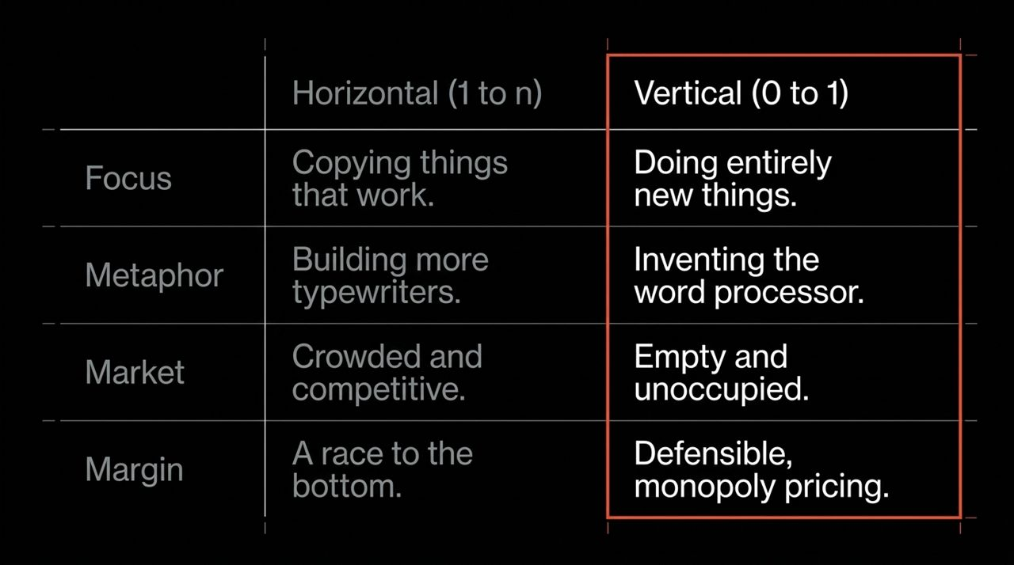
Notes:
Let's look at how horizontal and vertical progress differ across key dimensions:
Focus: Horizontal is about copying things that work. Vertical is about doing entirely new things.
Metaphor: Horizontal is building 100 typewriters. Vertical is inventing the word processor.
Market: Horizontal lands you in a crowded, hyper-competitive red ocean. Vertical places you in an empty, unoccupied blue ocean.
Margin: In a horizontal market, competition drives profit margins down to near zero—it's a race to the bottom. In a vertical market, because you have created unique value, you enjoy defensible, monopoly pricing power.

Slide 5
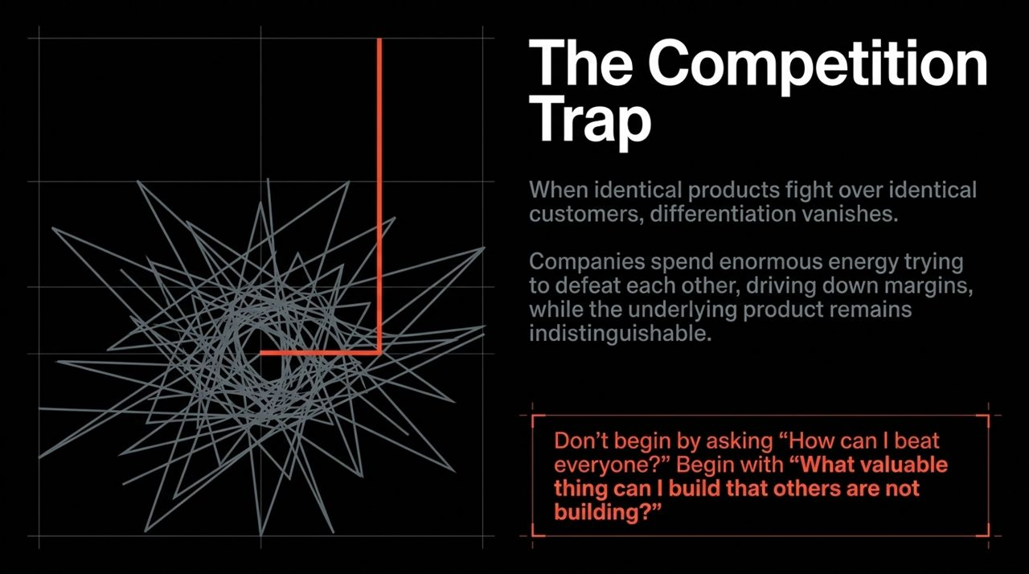
Notes:
Why are people so obsessed with competition? Because our society conditions us for it. School ranks us on identical criteria; corporate ladders pitted us against peers.
When identical products fight over identical customers, true differentiation vanishes. Companies waste vast amounts of capital, engineering talent, and energy trying to beat each other by 1%.
Look at the airline industry vs. Google. US airlines move millions of people and generate hundreds of billions in revenue, but under intense competition, they earn tiny profit margins per passenger trip. Google creates massive value and captures high margins because it faces no direct equivalent.
Don't ask 'How can I beat everyone?' Ask 'What valuable thing can I build that others are not building?'

Slide 6
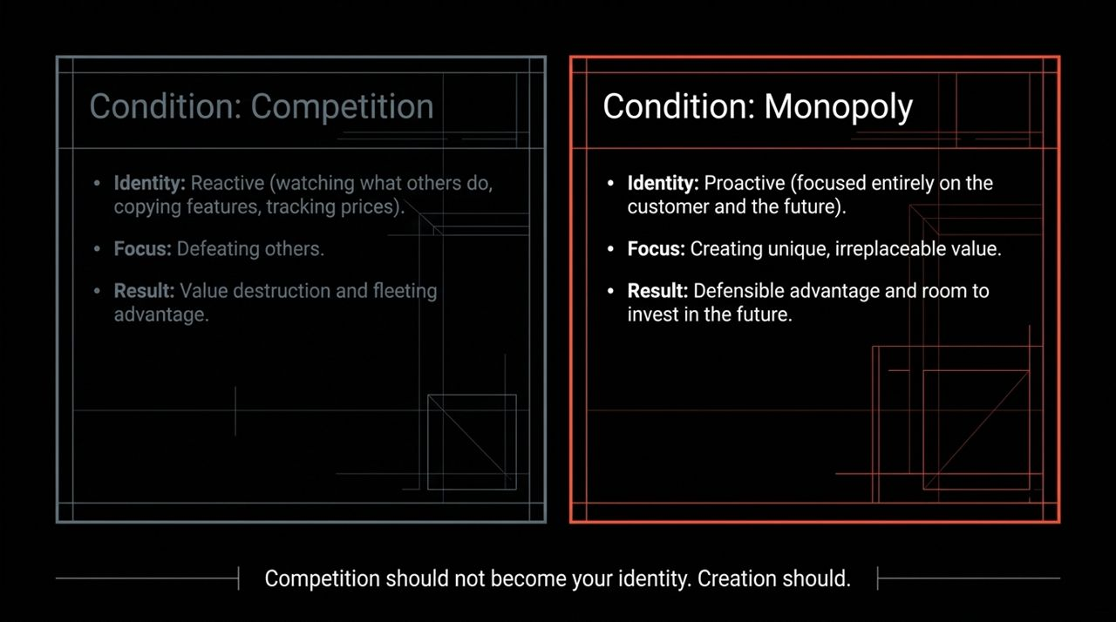
Notes:
Let's contrast the operational realities of these two conditions:
Under Competition: Your identity becomes reactive. You track competitor pricing daily, copy features, and react to press releases. Your focus is purely on defeating others. The result? Profit margins disappear, value is destroyed, and any advantage is fleeting.
Under Monopoly: (And by 'monopoly,' I mean a creative monopoly—a company so good at what it does that no other firm can offer a close substitute). Your identity is proactive. You focus on the customer and the long-term future. The result is high margins, allowing you to invest in long-term R&D.
Competition shouldn't become your identity. Creation should.

Slide 7
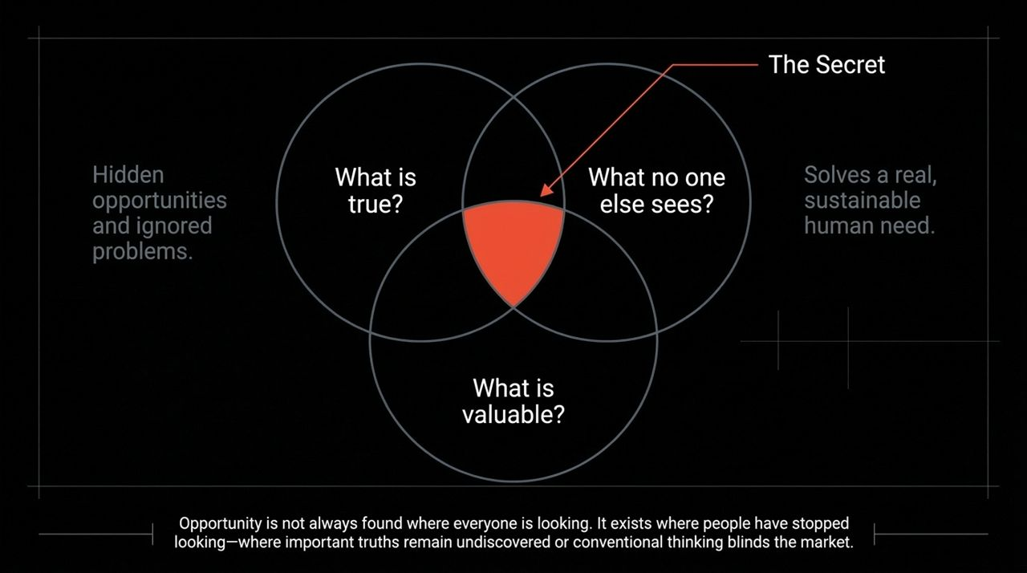
Notes:
How do you find 0-to-1 opportunities? You start by uncovering a Secret.
Thiel asks a core interview question: 'What important truth do very few people agree with you on?'
A great business secret lies at the intersection of two questions:
What is true? What hidden technical or human reality is currently ignored or unseen by the consensus?
What is valuable? What real, sustainable human need can be solved using this insight?
If everyone agrees with your premise, it's already priced into the market. Opportunities exist where people have stopped looking—where conventional wisdom blinds competitors.

Slide 8
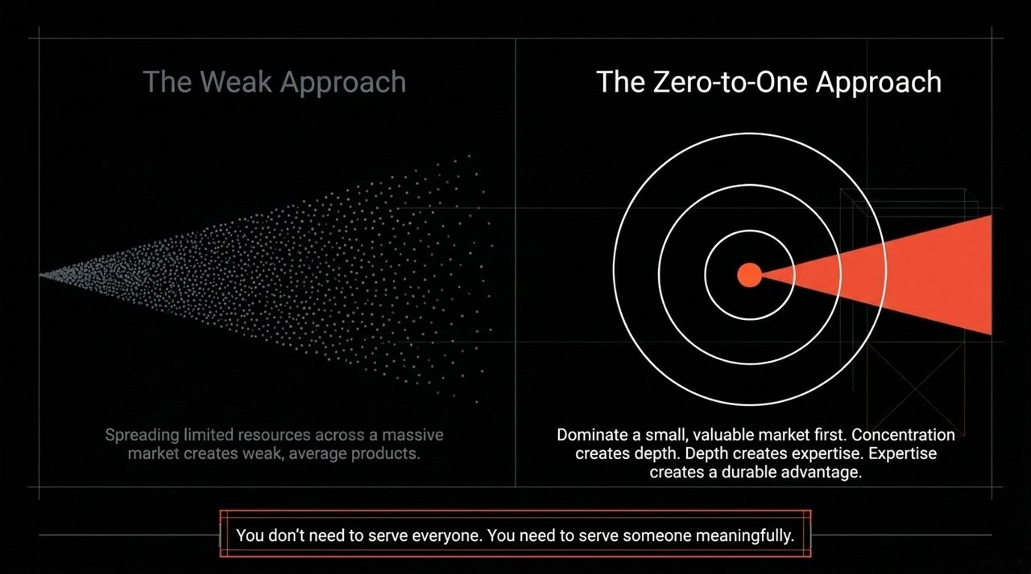
Notes:
A common mistake early startups make is trying to capture 1% of a $100 billion market.
The Weak Approach: Spreading limited resources across a massive market results in an average product that appeals to no one specifically.
The Zero-to-One Approach: Dominate a small, specific niche first. Amazon started purely with books before moving to general retail. eBay started with beanie babies and collectibles sellers. PayPal focused first on eBay power sellers.
Concentration creates depth; depth creates domain mastery. You don't need to serve everyone right away; you need to serve a specific audience exceptionally well.

Slide 9
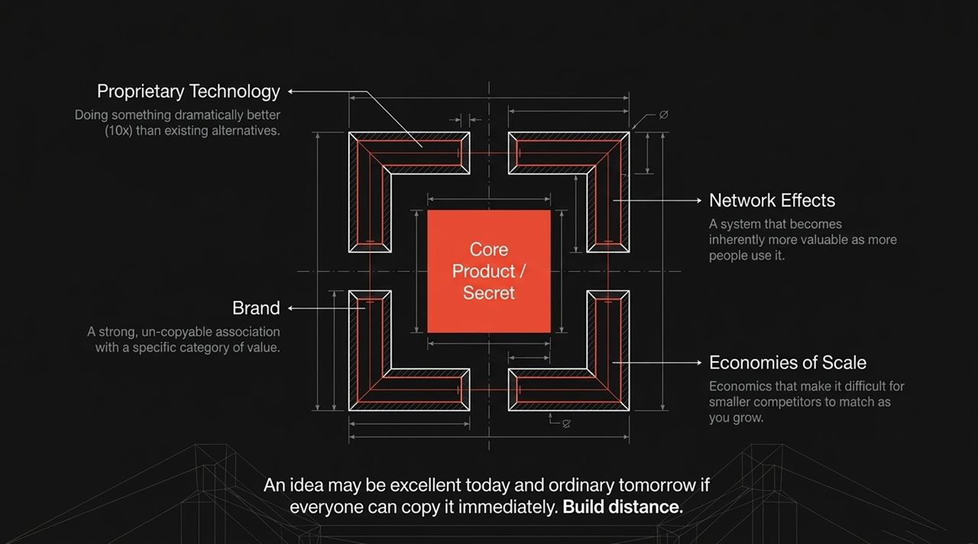
Notes:
Creating value isn't enough; you must also capture and defend it. Durable companies build four primary moats around their core innovation:
Proprietary Technology: Your solution should be at least 10x better than the nearest alternative, making substitution difficult.
Network Effects: The product naturally becomes more valuable as more people use it (e.g., social networks, marketplaces).
Economies of Scale: Fixed costs are spread over larger volume, giving you lower cost structures as you grow.
Brand: A strong identity and reputation that creates an un-copyable category association.

Slide 10
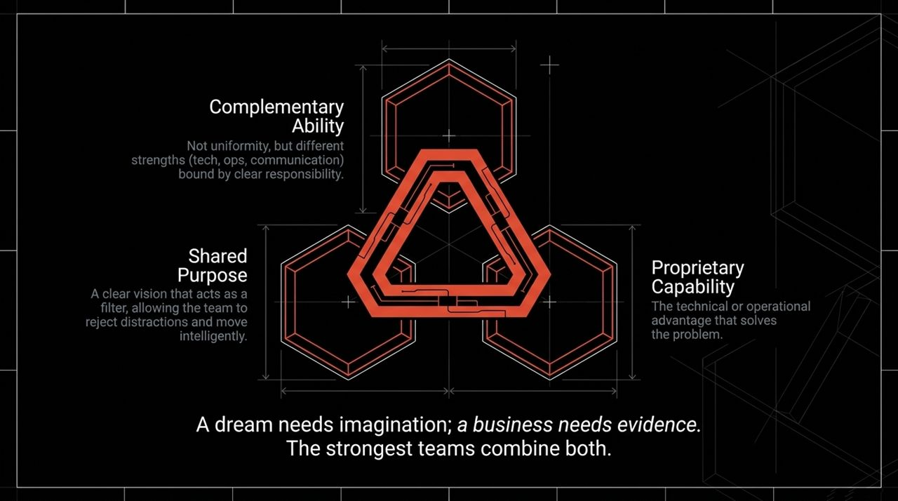
Notes:
A brilliant insight fails without proper execution. High-performing startup teams require three key elements working together:
Complementary Ability: Avoid hiring carbon copies of yourself. You need technical capability, operational excellence, and clear communication working in harmony.
Shared Purpose: A clear vision that keeps the team aligned and focused on what matters.
Proprietary Capability: The core technical or operational execution that solves the hard problem.
A dream needs imagination, but execution requires structure.

Slide 11
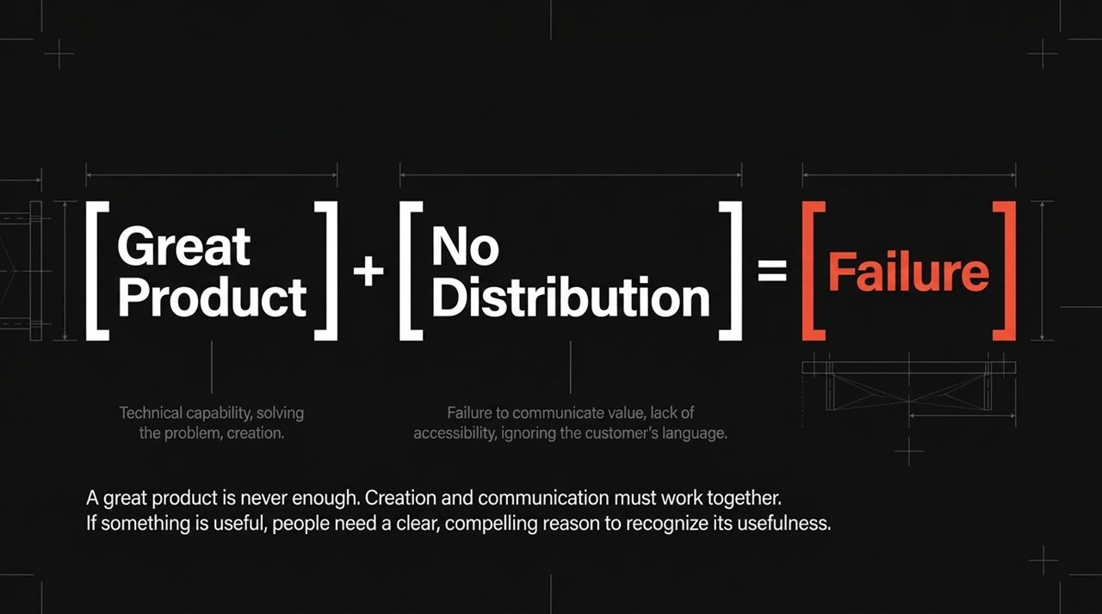
Notes:
Engineers often believe that if you build a superior product, customers will automatically show up. This is rarely true.
Great Product + No Distribution = Failure.
Distribution matters just as much as product development. You must design your distribution channel with the same rigour as your core software or hardware.
Whether it's complex direct sales, personal sales teams, or viral channels, mastering how your product reaches the customer is critical to success.

Slide 12
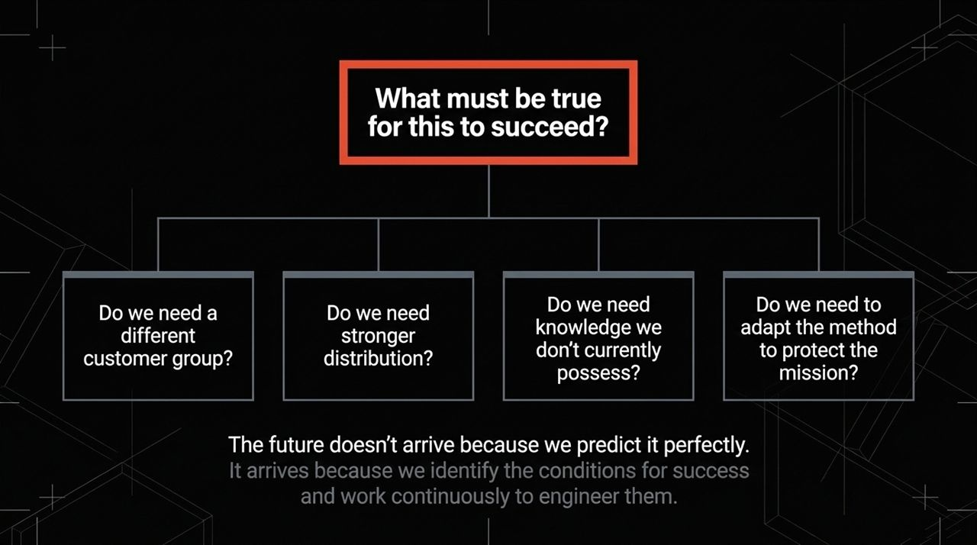
Notes:
The future does not arrive by accident or by reacting to trends. It is shaped by those who actively plan for it.
To engineer success, ask yourself critical questions:
What conditions must be true for this venture to succeed?
Do we have the right distribution channels?
Do we possess the required technical capabilities?
How will we adapt our methods while preserving our core mission?
Rather than treating the future like a lottery ticket, view it as something you can plan and build.

Slide 13
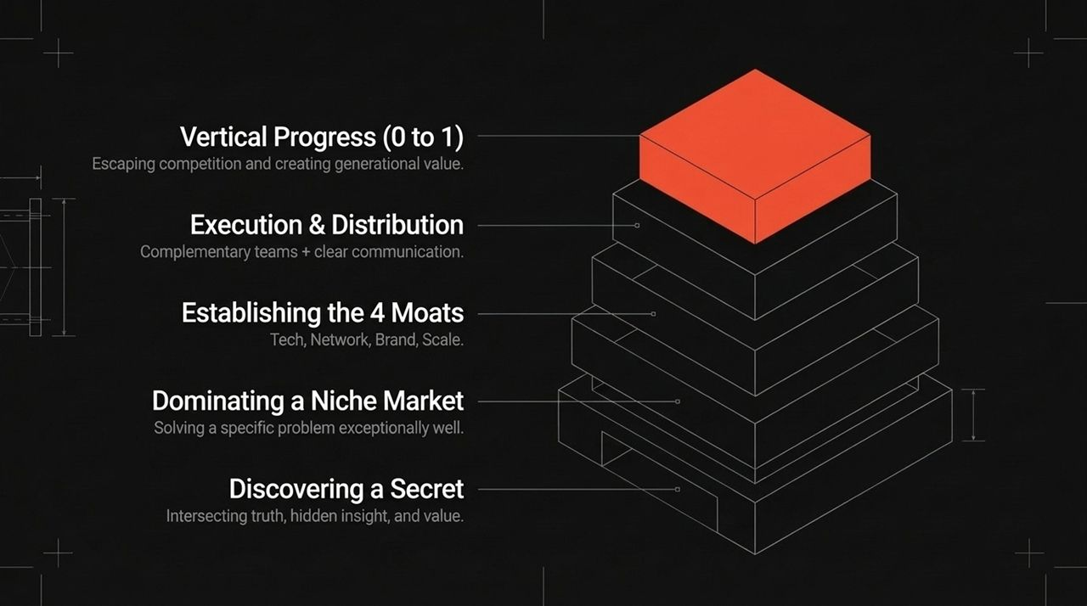
Notes:
Let's review the step-by-step roadmap for moving from 0 to 1:
Discover a Secret: Identify a hidden, non-obvious truth that creates new value.
Dominating a Niche Market: Start small, focus your resources, and dominate a specific segment first.
Establishing Moats: Protect your advantage through technology, network effects, scale, or brand.
Execution & Distribution: Build aligned, complementary teams and pair product design with effective sales channels.
Vertical Progress: Escape competition and build durable, long-term value.

Slide 14

Notes:
We arrive at the central question of this session:
If you could create something valuable that does not exist today, what would you choose to build?
The future isn't guaranteed, nor does it happen automatically. It is shaped by founders, leaders, and creators who choose to step away from comfortable imitation and build something genuinely new.

Slide 15
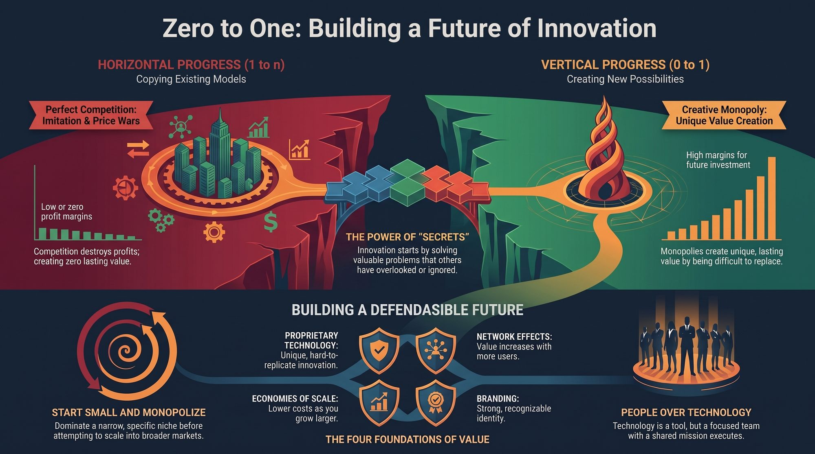
Notes:
To wrap up our core presentation, this infographic summarizes the key pillars of our discussion:
Horizontal vs. Vertical Progress: Shift from 1-to-n imitation toward 0-to-1 creation.
The Power of Secrets: Focus on non-obvious problems worth solving.
Defensible Foundations: Secure your position using proprietary technology, network effects, economies of scale, and branding.
Team & Focus: Build dedicated teams with clear missions and dominate targeted niches before scaling.
Thank you. Let's now open the floor to questions and discussion.
https://www.youtube.com/watch?v=Eu0ShMNCChY

